Slide 1

SILDENAFIL – Past , Present ,and Future.
Dr PK Rajiv
MBBS, DCH,MD FRCPCH, FIAP
Fellowship in Neonatology(Australia) ex Professor of Neonatology
Amrita Institute of Medical Sciences kochi INDIA. Pin 682027
Founder President of Indian Academy Pediatrics Emirates Neonatal Chapter 2019-2026

Slide 2
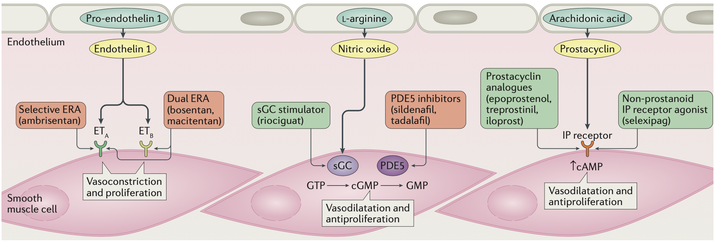
Sildenafil in PPHN – Where Do We Stand
Endothelin Pathway
Nitric oxide Pathway
Prostacycline Pathway
Bosentan
NATURE REVIEWS | CARDIOLOGY ,OCT 2017

Slide 3
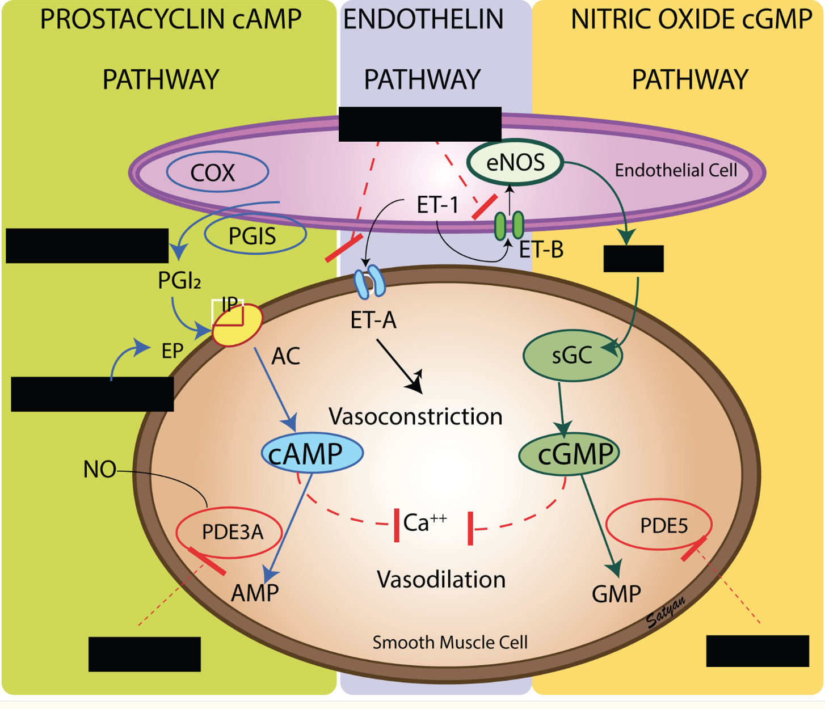
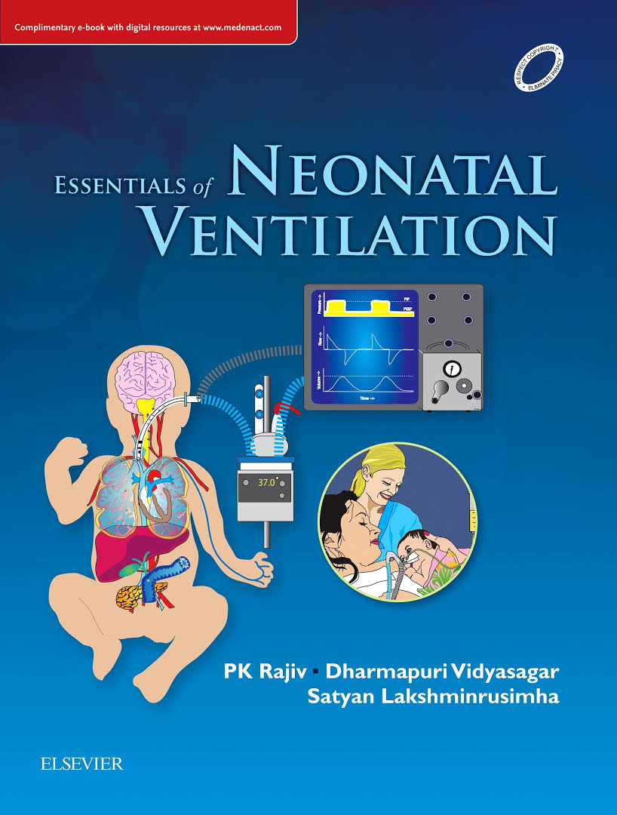
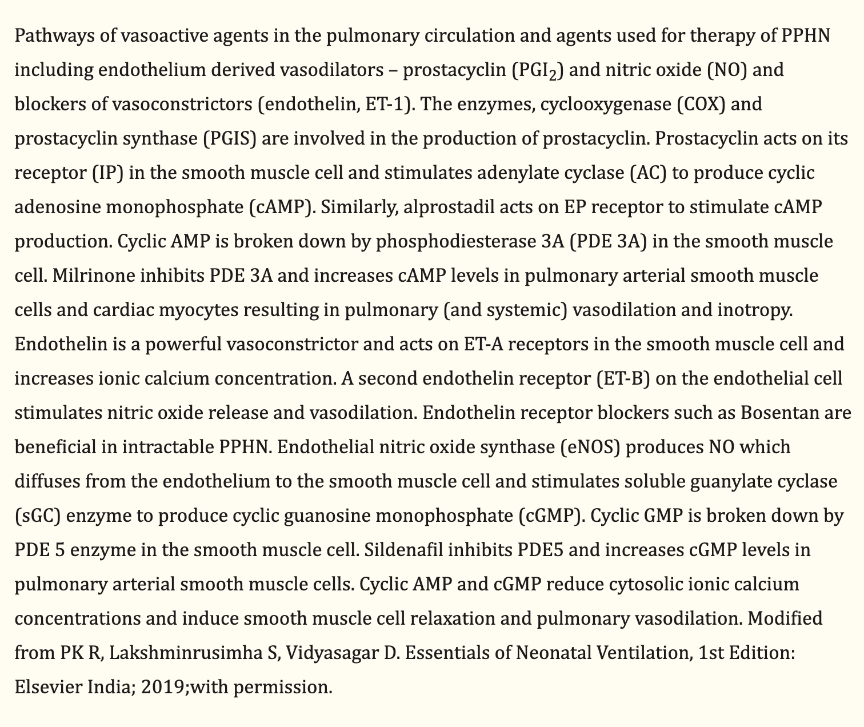
Pathophysiology

Slide 4

Research 2002 To 2024
My journey with sildenafil

Slide 5
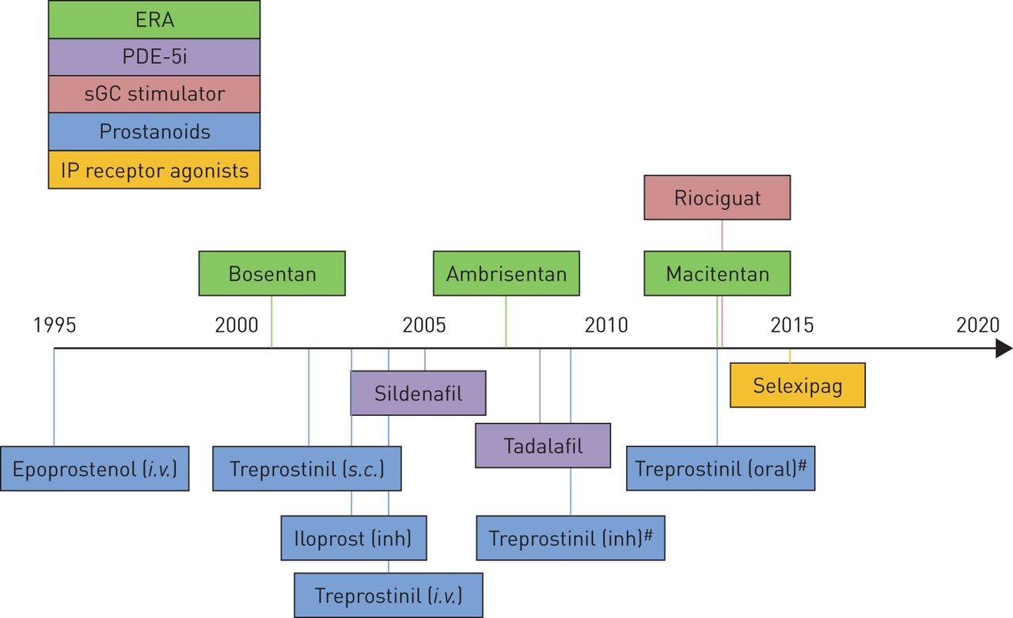


THERAPIES APPROVED FOR PULMONARY ARTERIAL HYPERTENSION
Sildenafil (Oral)
AIIMS, Kochi
2002
Sean Gaine and Vallerie McLaughlin Eur Respir Rev 2017;26:170095

Slide 6
2006
Baquero et al
(Oral sildenafil)
2018
Nazia et al
(Sildenafil vs sildnfl + Bosentan)
2019
CoDiNOS trial
(IV sildenafil vs iNO in CDH)
2021
Sildenafil vs Nebulised Mgso4 + sildenafil
(ongoing)
2010
Sinan et al
(Sildenafil vs Mgso4)
2016
Omar et al
(Oral sildenafil + iNO)
2006
2009
2010
2014
2016
2017
2018
2019
2020
2021
2009
Steinhorn et al
(IV sildenafil)
2014
DILATE trial
(Riociguat – adult study)
2017
Kamaz et al
(Oral sildenafil + iNO)
2018
MINT trial
Milrinone in PPHN
)
2020
Ghandour et al
(Sildenafil + Milrinone)
2020
SILDI SAFE trial
(Safety of sildenafil in preterms)

Slide 7
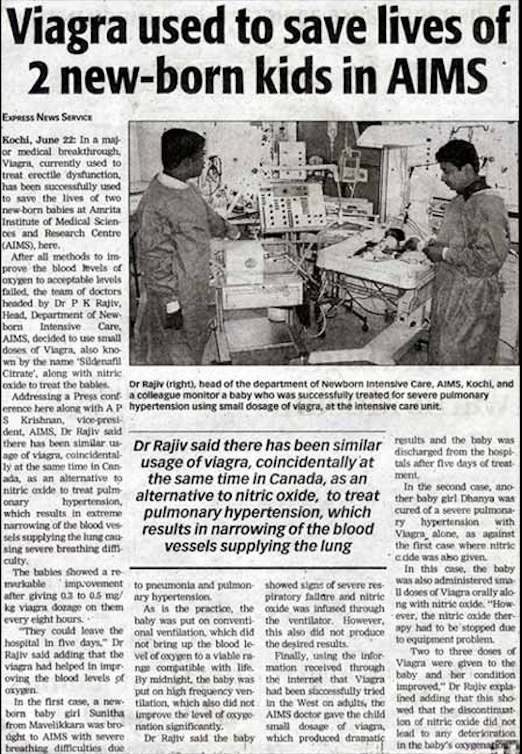
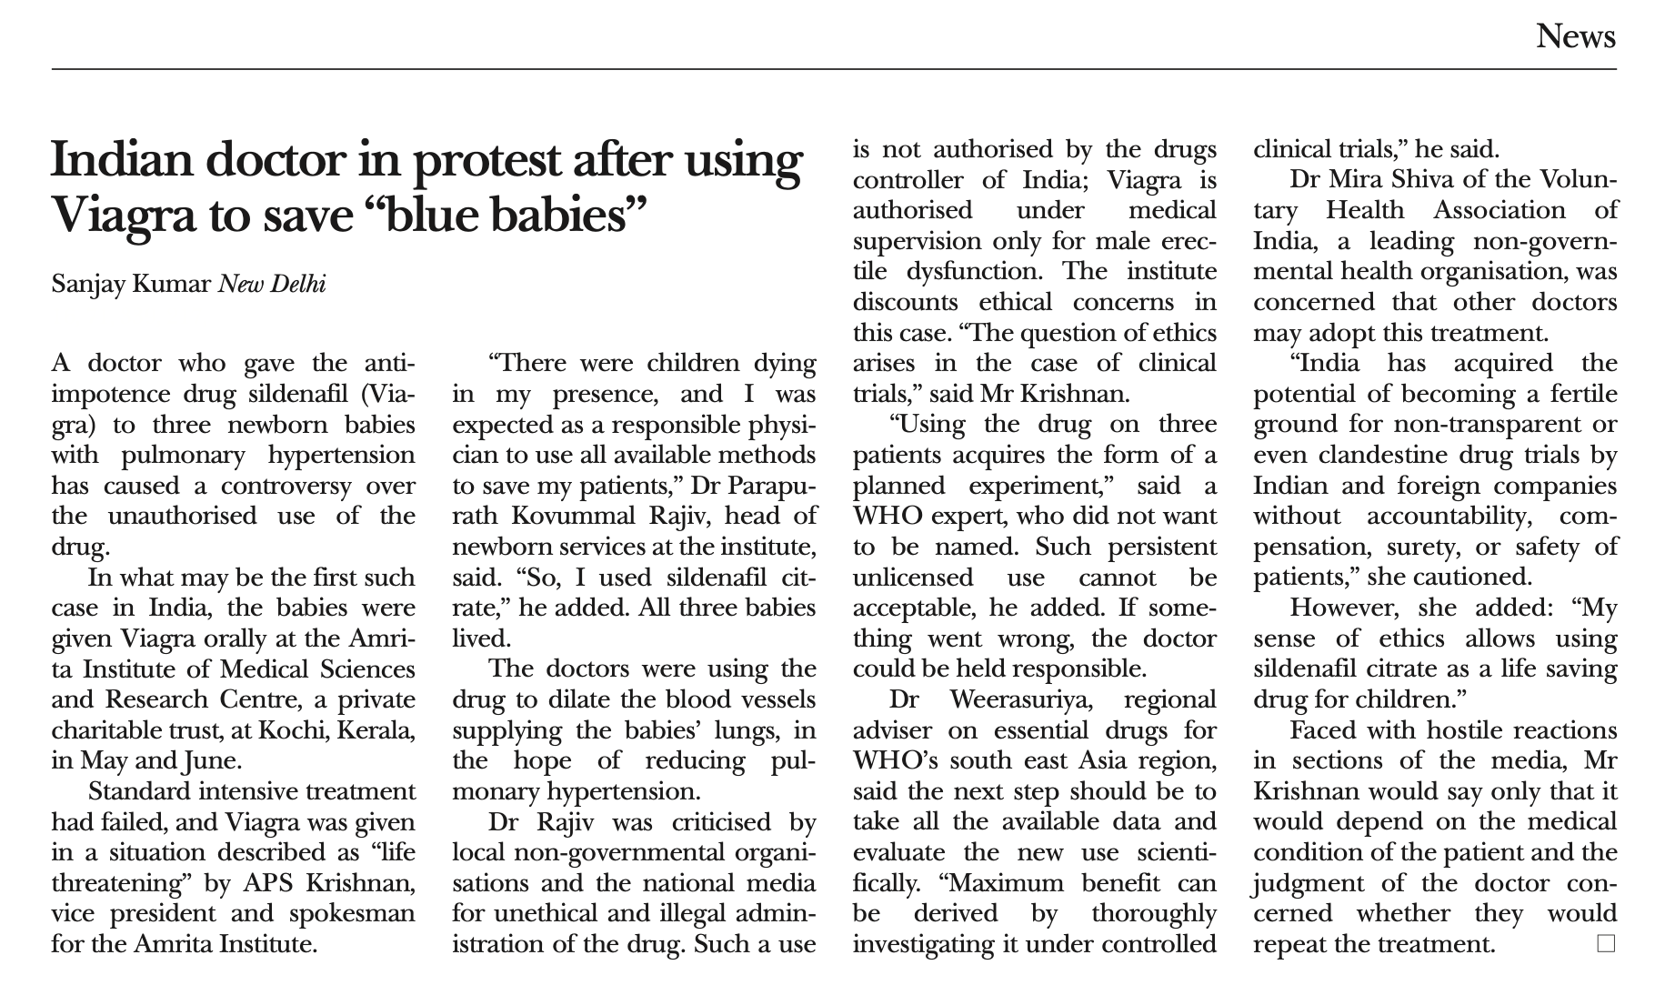
Travelled A New Path
way back 2002
In 2002 Sildenafil First time used successfully
in Neonates With PPHN
AIMS,KOCHI ,INDIA
BMJ news,2002

Slide 8
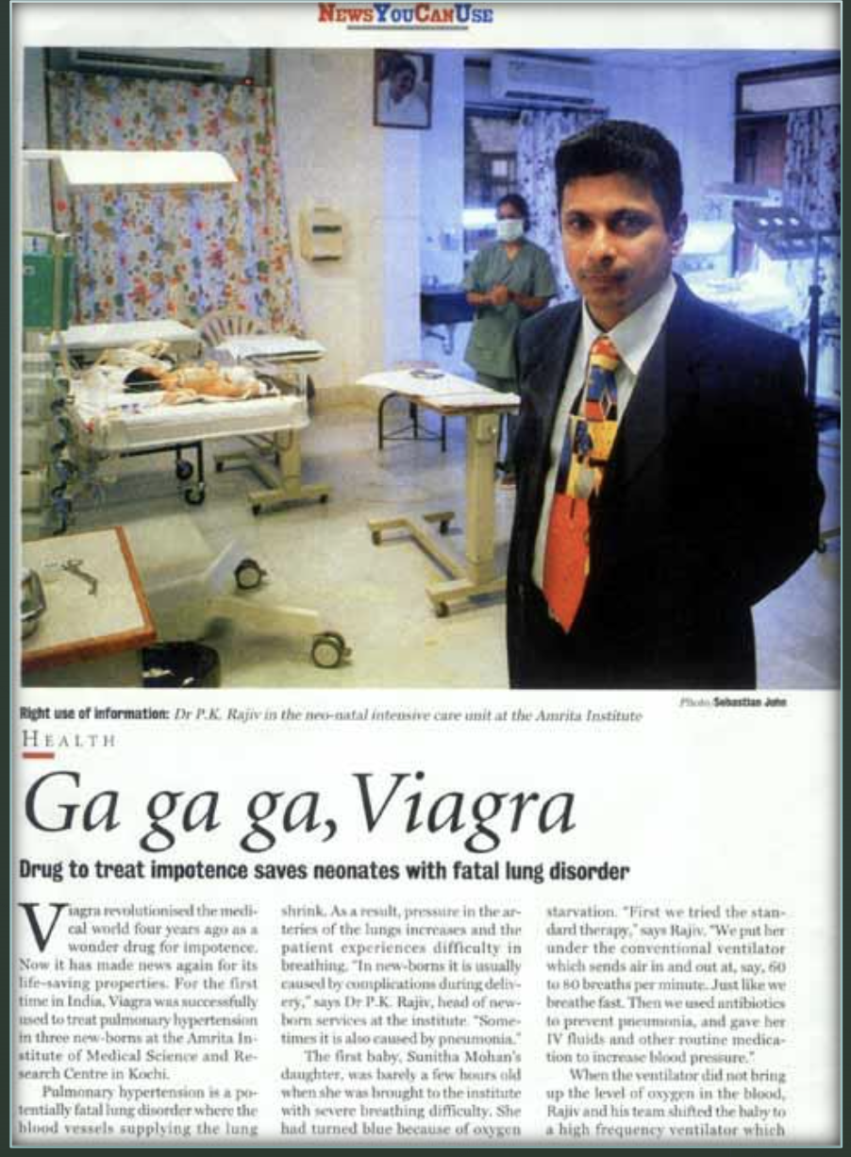
Viagra to save blue babies-balancing ethics, conscience, and science with limited resources ( BMJ 2002)
BMJ 2002; 325 doi: https://doi.or g/ 10.1136 /bmj.325.7357.181
( 27 July 2002)
Data presented at Hot Topics in Neonatology conference Washington D.C (Dec 2002)

Slide 9

Inhaled nitric oxide (iNO) is considered the mainstay in the treatment of pulmonary hypertension in term or near term neonates .
Approximately 30% of neonates with PPHN fail to respond to iNO (Goldman 1996).
Nitric oxide therapy is associated with rebound PAH when therapy is discontinued - suppression of endogenous NO production (Kinsella 2000)
Nitric Oxide is a costly intervention and Not without Adverse Effects
Many Part of world medical grade of NO is not available
Transport of PPHN Neonates – IV Sildenafil Vs Nitric Oxide

Slide 10
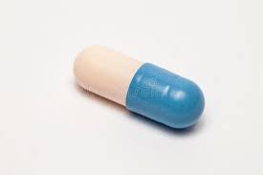
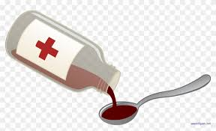
Oral Sildenafil
0.25 – 0.5 mg/kg/dose every 4 to 8 hours
Maximum dose of 2mg/kg/dose 6 hourly.
<37 Weeks Corrected Gestational Age
Loading
Maintenance
Loading: 0.13mg/kg/hour administered over 45 minutes
Maintenance :0.02 to 0.05 mg/kg/hour
> 37 Weeks Corrected Gestational Age
Loading: 0.13mg/kg/hour administered over 3 hours
Maintenance : 0.07mg/kg/hour
Intermittent
0.5 mg /kg every 8 hrs over 15-60 min

Slide 11

Original Data sheet Of 2002 sildenafil treated babies June 2002

Slide 12
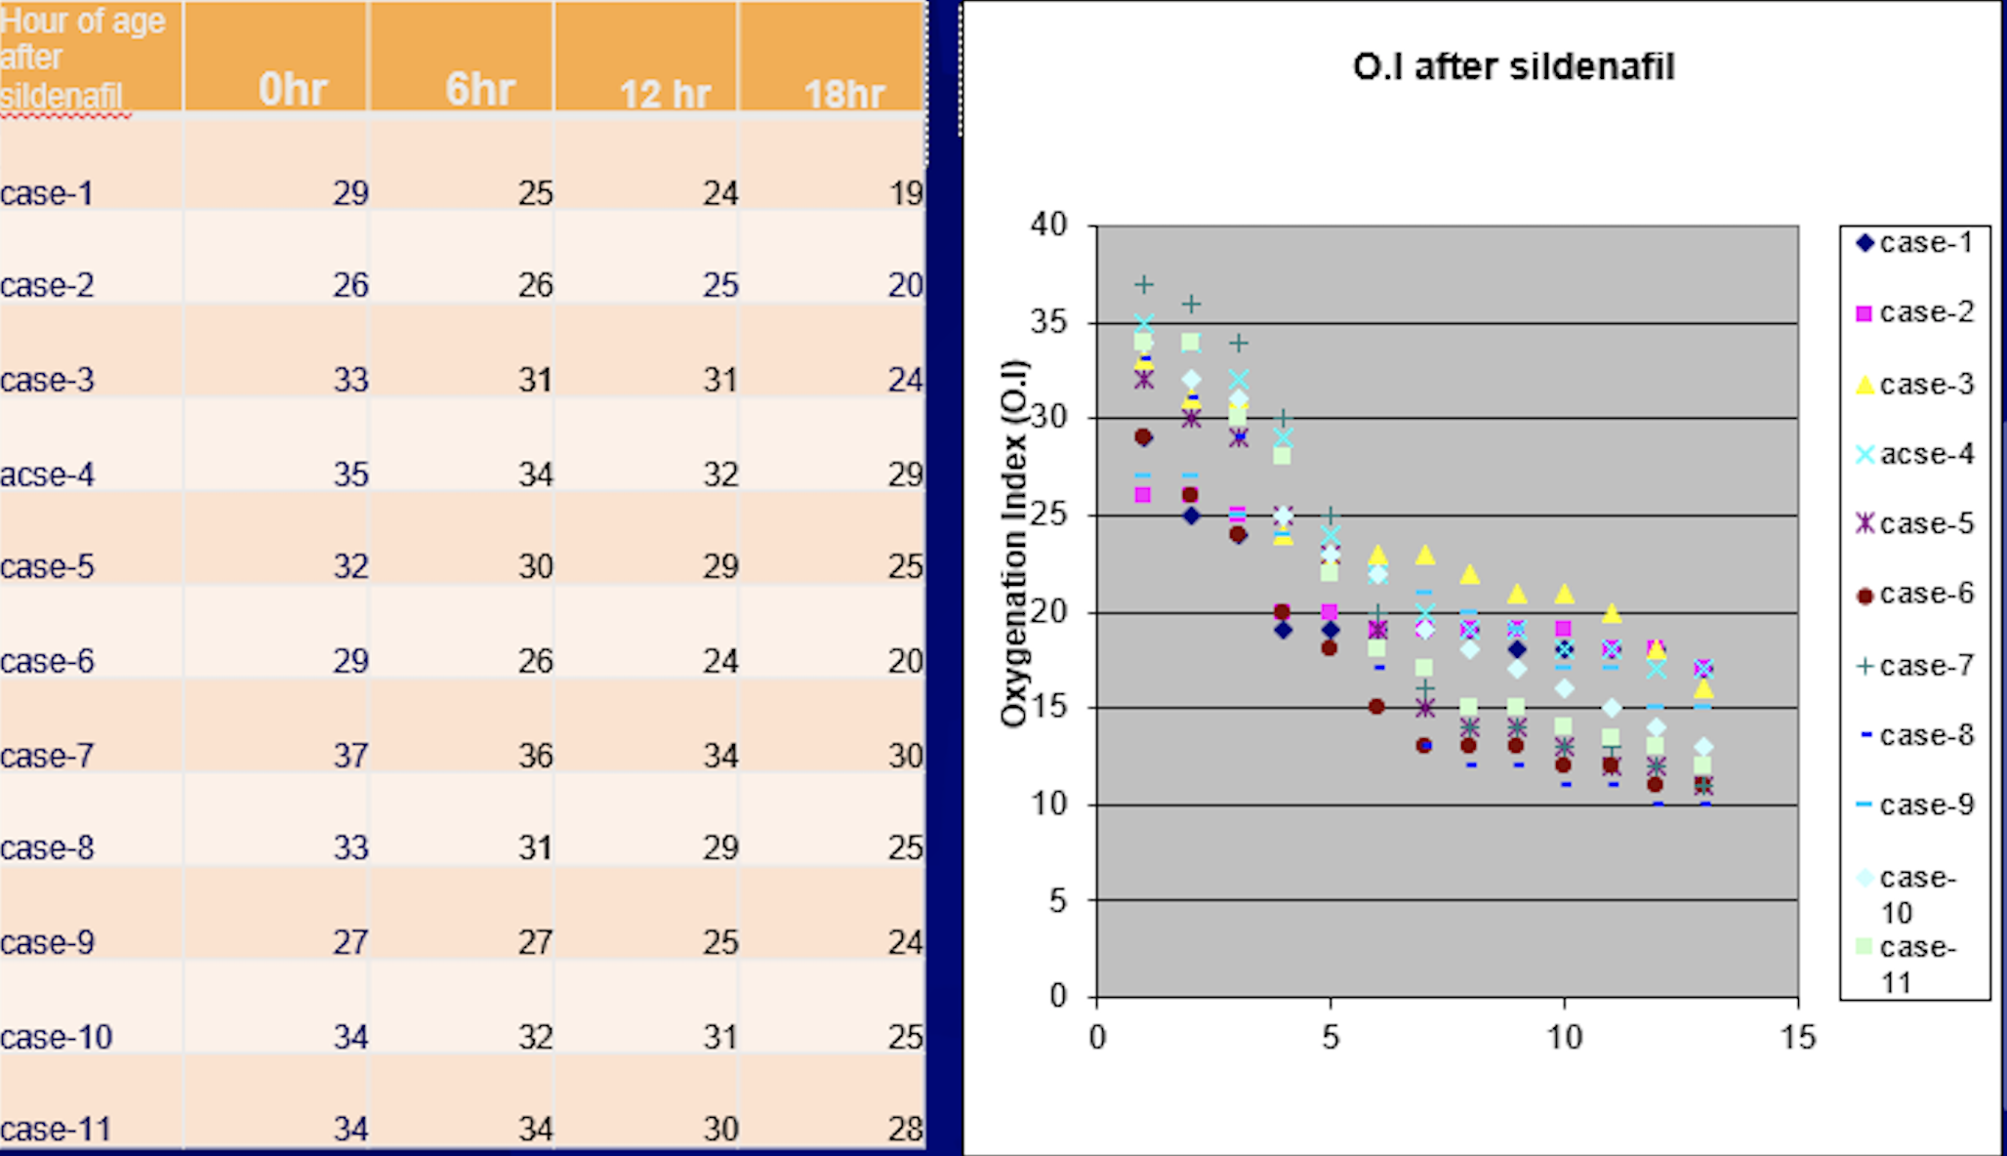
DATA AIMS KOCHI, Sildenafil Oral
2002
Significant improvement of OI by 10-12 hrs
PK Rajiv

Slide 13
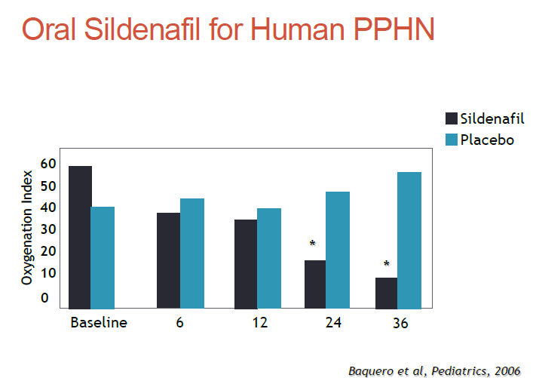
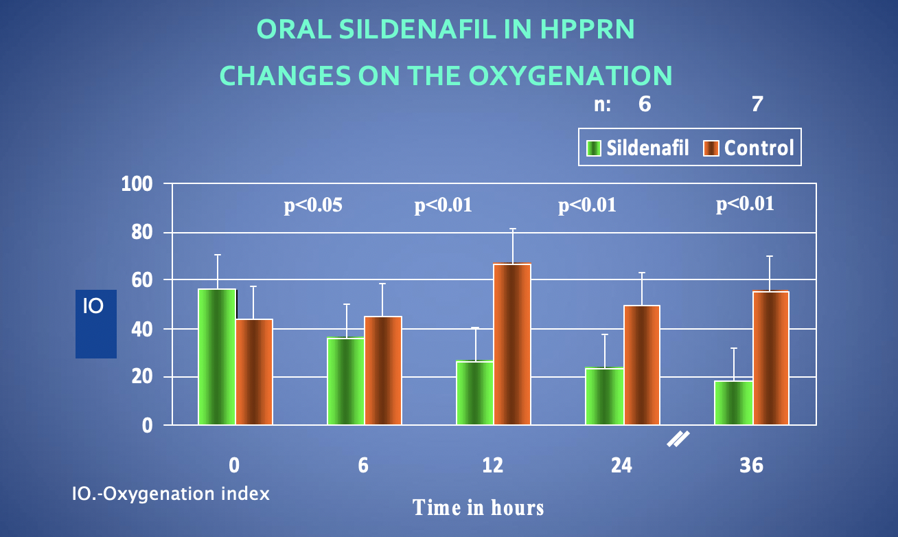
2006

Slide 14
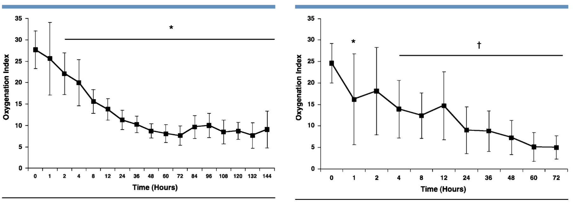
2009
Intravenous Sildenafil in the Treatment of Neonates with Persistent Pulmonary Hypertension .Steinhorn R.H , Journal of Pediatrics
whole population
without NO
OI improvement starts at 1 hour, Peak at 4 hrs , @ 24 hrs 27.3 to 11.7 ,P=0.001

Slide 15
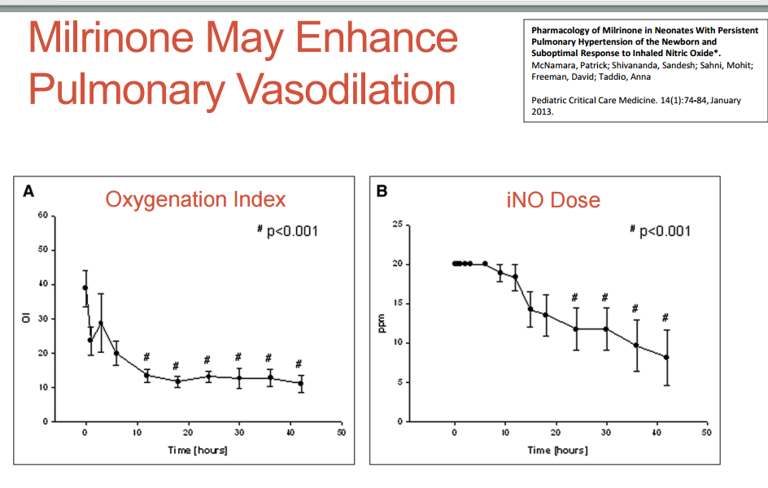
2013

Slide 16

Endothelin receptor antagonists for persistent pulmonary hypertension in term and late preterm infants
Bosentan
Kiran More etal.
18 August 2016
There is inadequate evidence to support the use of ETRAs either as stand-alone therapy or as adjuvant to inhaled nitric oxide in PPHN. Adequately powered RCTs are needed.
Bosentan was well tolerated but did not improve oxygenation
Steinhorn RH etal ,FUTURE-4 study. J of Pediatrics Oct 2016.
May be appropriate for PPHN with CDH, BPD

Slide 17
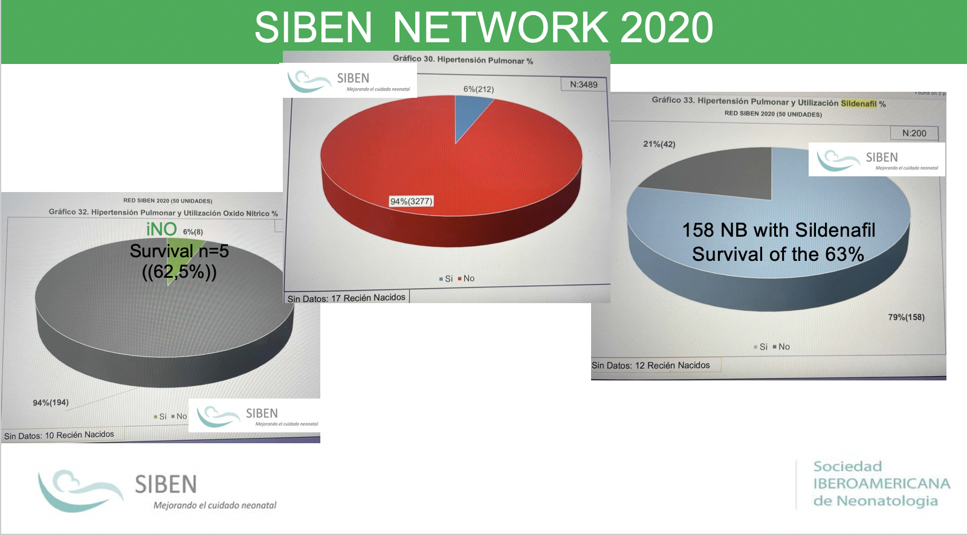
Dr Augosto Sola

Slide 18


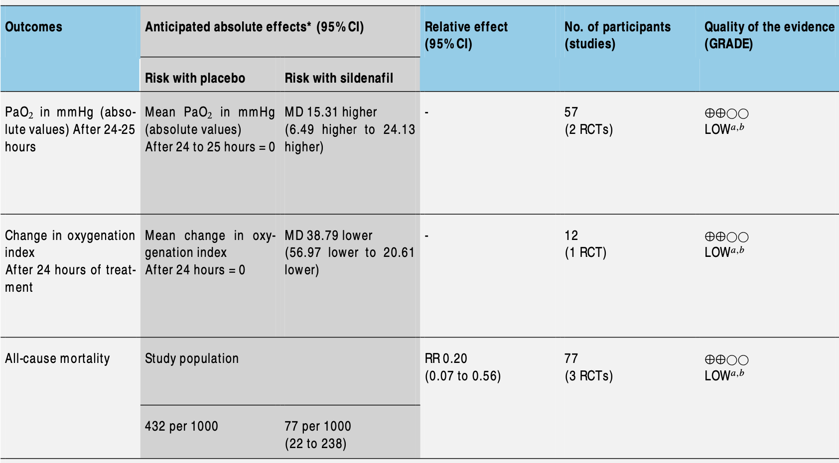
2017 ,77 Neonates
PaO2 improves by 15.31 mmHg by 24 hrs
OI decrease by 38.79 by 24 hrs
Mortality decreases by 80%

Slide 19
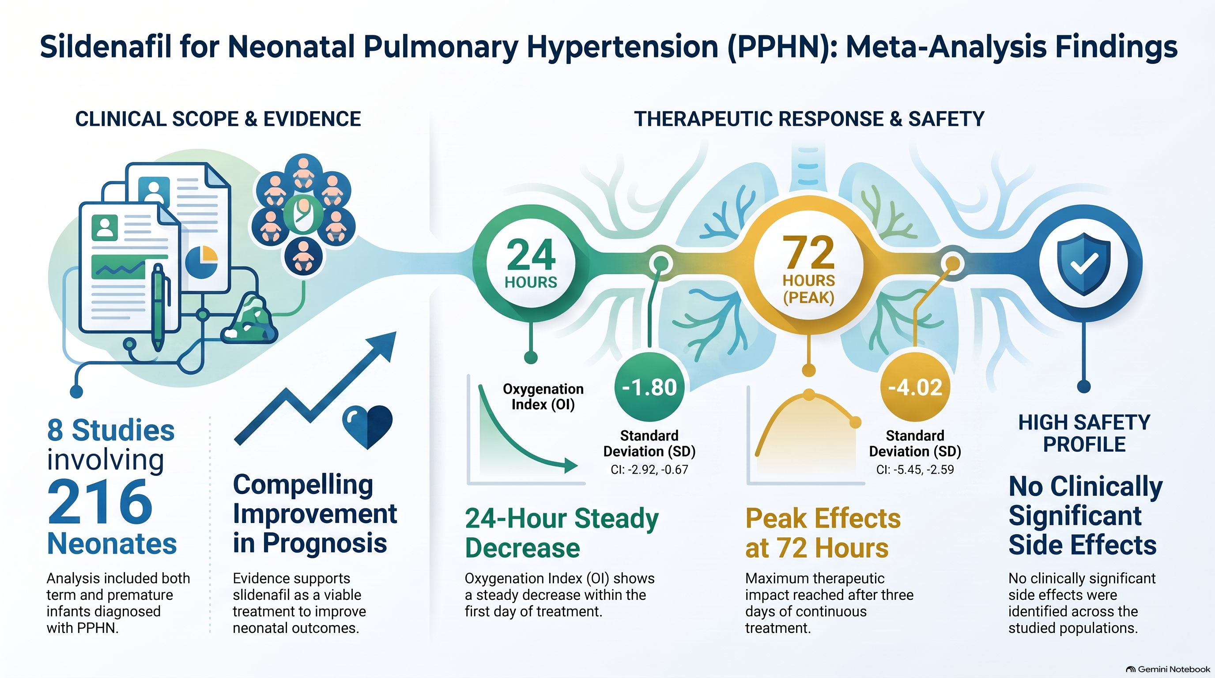
Sildenafil for pulmonary hypertension in neonates: An updated systematic review and meta‐analysis , Pediatrics Pulmonology , April 2021.
8 studies were included with 216 term and premature neo- nates with PPHN
Compelling evidence showed the use of sildenafil could improve the prognosis of PPHN neonates,
After 24 h of treatment
OI steady decrease (SD: −1.80, 95% CI: −2.92, −0.67)
Peak effects after 72 h of treatment (SD: −4.02, 95% CI: −5.45, −2.59).
No clinically significant side effects were identified

Slide 20
Sildenafil Plus – What is Evidence
Al Omar et al. | sildenafil with iNO vs. iNO | No meaningful statistical difference at any time point
Uslu et al. | SILDENAFIL VS IV MgSO4 | Decreased duration of mechanical ventilation, no difference in mortality, Significant decreased in PAP
Kahveci et al. | Sildenafil Vs Inhaled Iloprost | Decreased PAP, improved systemic hypotension
Fatima et al. | Sildenafil vs. 50 sildenafil with bosentan | Improvement in oxygenation, but combined use is better
El-Ghandour et al | Sildenafil vs. 20 sildenafil with milrinone | Better oxygenation parameters, lower mortality, but combined use is better.

Slide 21
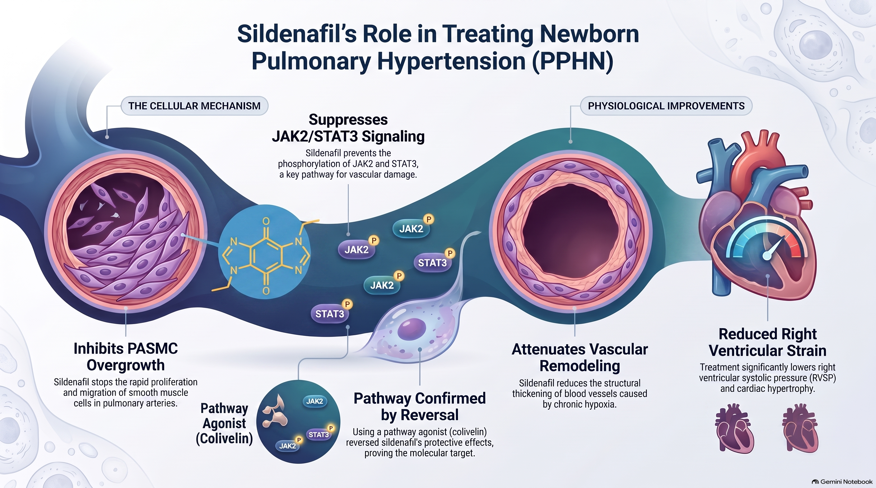
Sildenafil beyond Pulmonary vasodilatation – Repair and reversal of disease .
Journal of surgical research ,Feb 2025

Slide 22

Special considerations

Slide 23
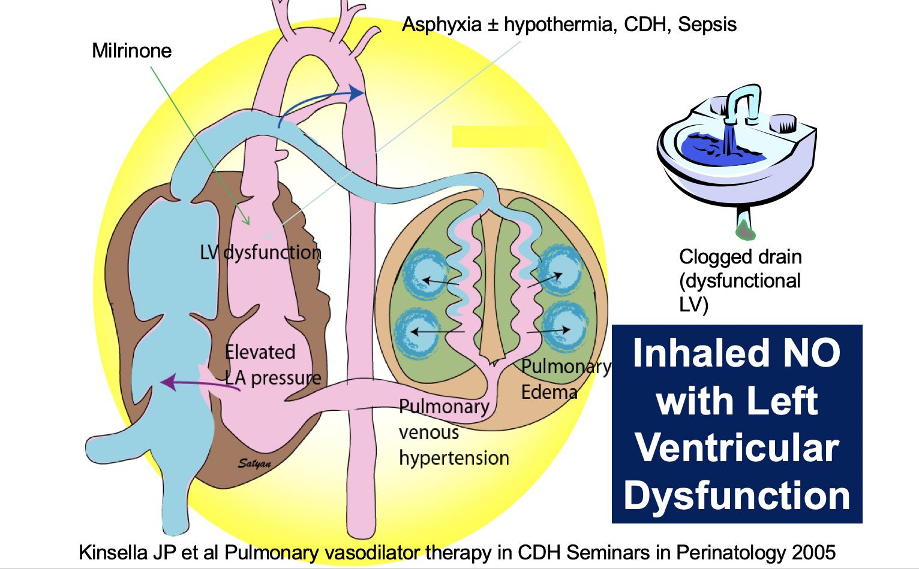

Slide 24
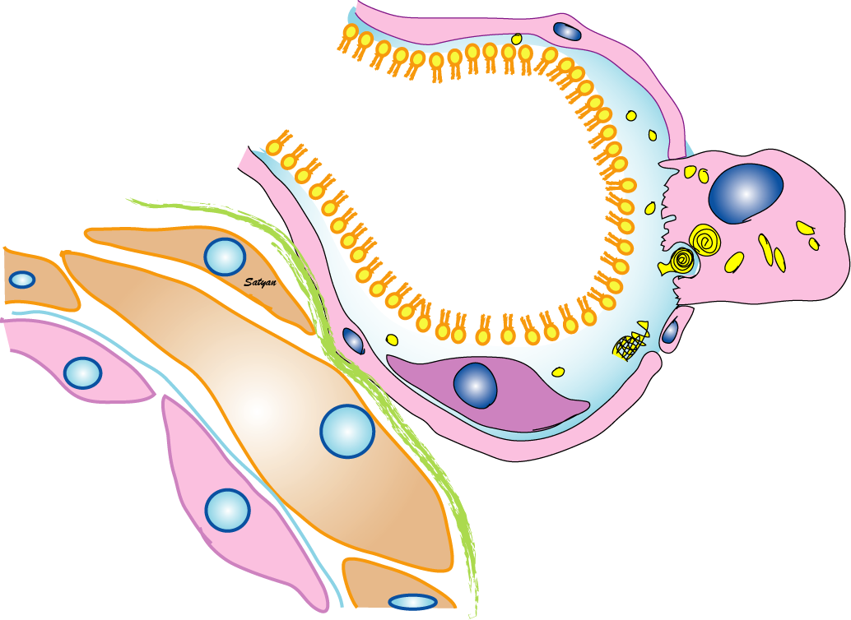
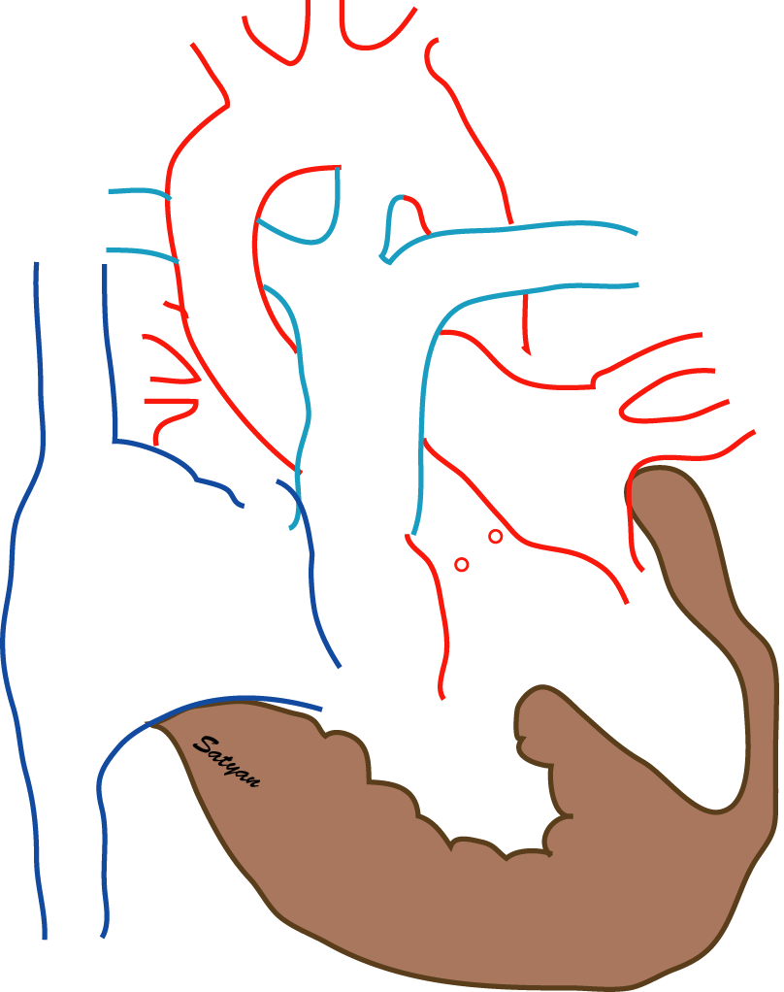
Liver Dysfunction
Dual source of cGMP
Sepsis
NO
NO
NO
NO
NO
NO
NO
When systemic sepsis (including viral) is suspected, use caution with sildenafil
CNP
sGC
NO
cGMP
pGC
PDE5
cGMP
BNP
Dr Satyan Lakshminrushimha

Slide 25
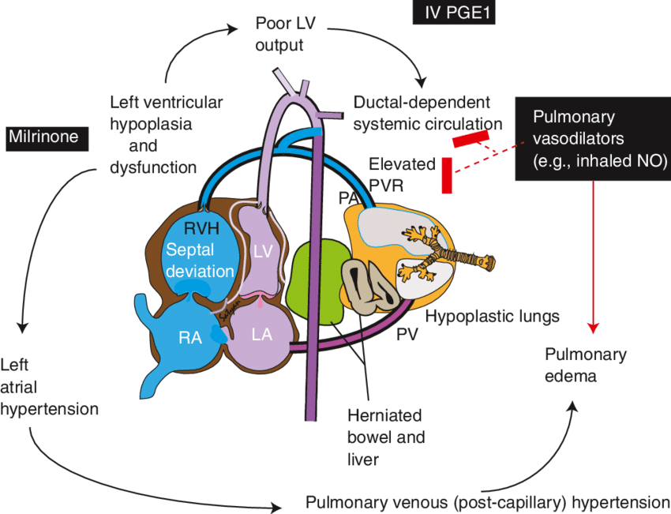
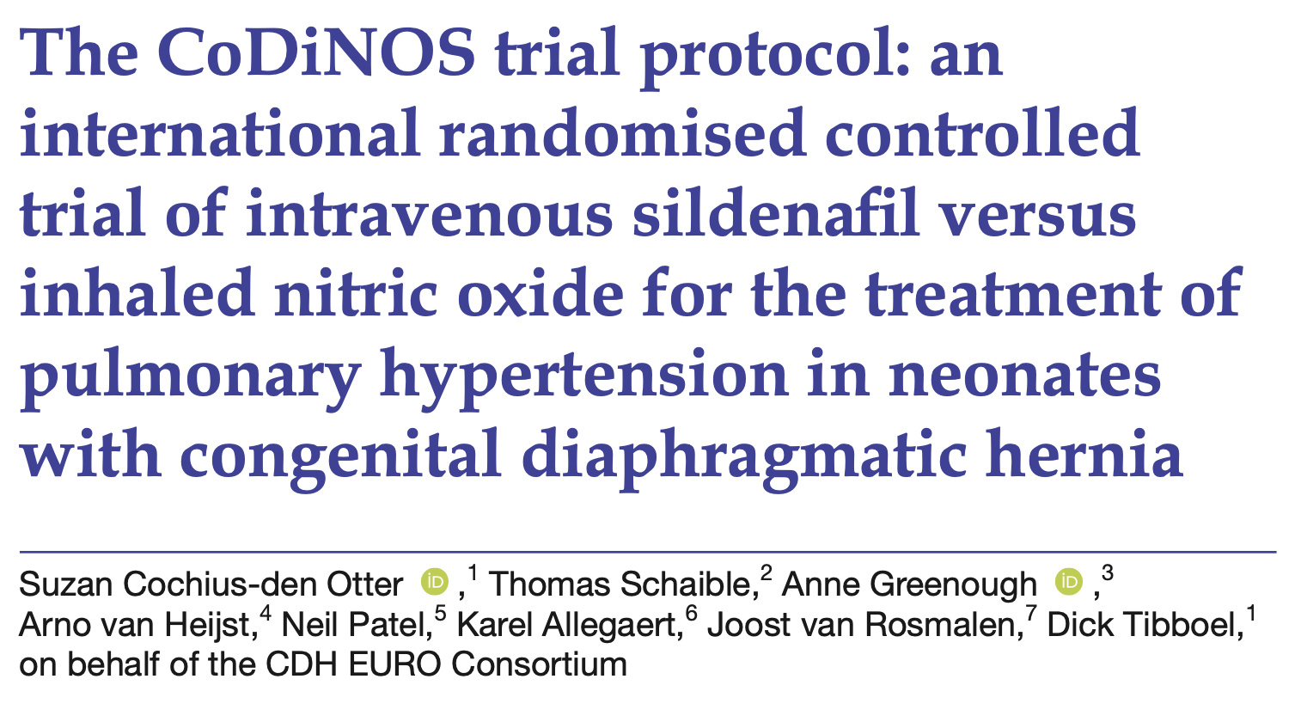
PPHN in CDH
2019

Slide 26
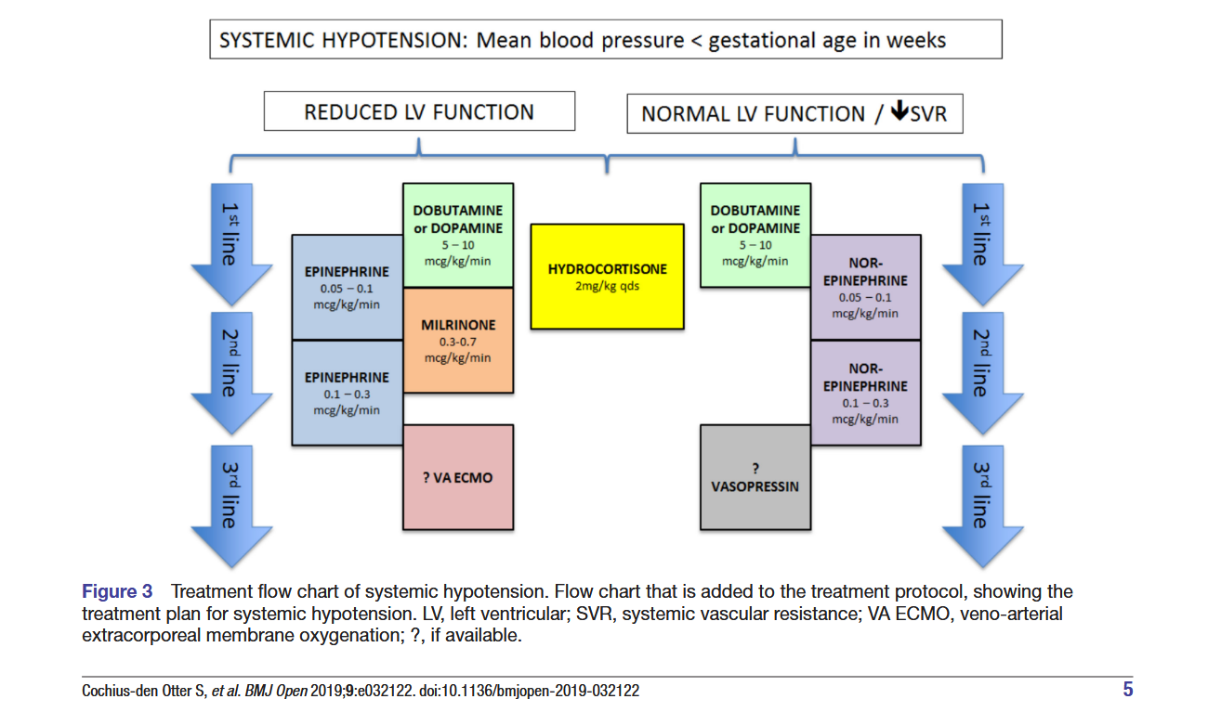

Slide 27
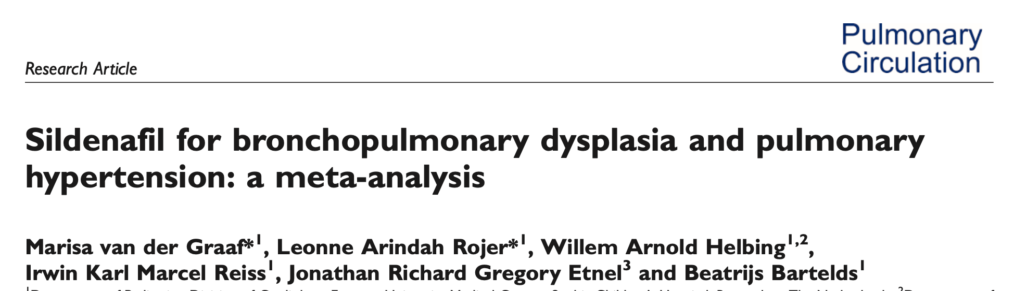
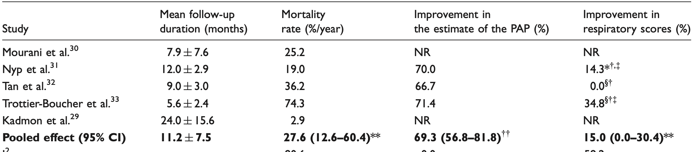
2019
Improvement in PAP and Respiratory score with Inconsistent effect on Mortality

Slide 28

Basic principles
Optimise lung volume USG
ventilation
Peep
preload
Perfusion
Posterior tibial pulsation

Slide 29
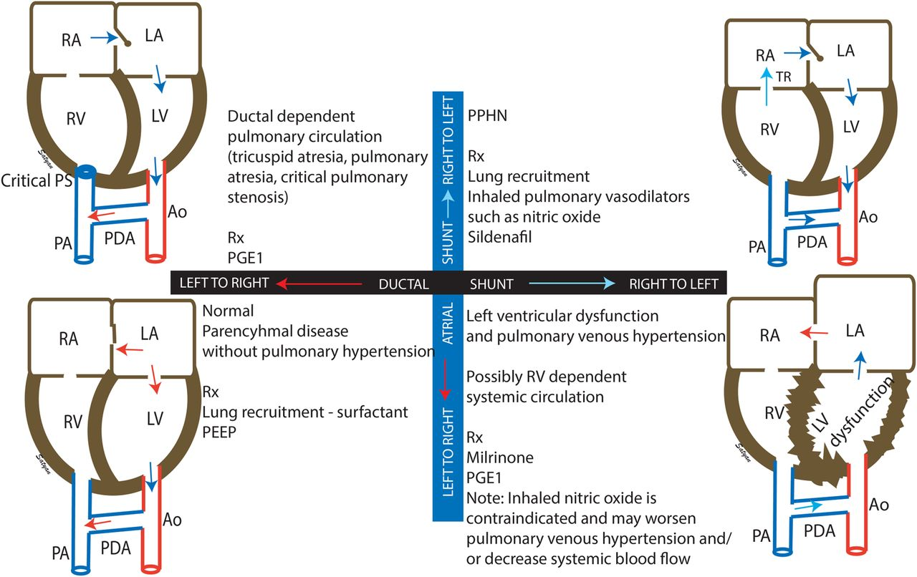
Goal Directed therapy in PPHN

Slide 30
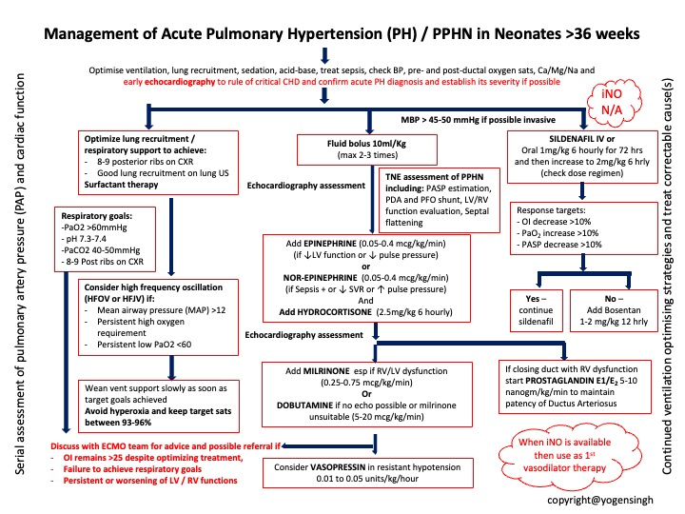

Slide 31
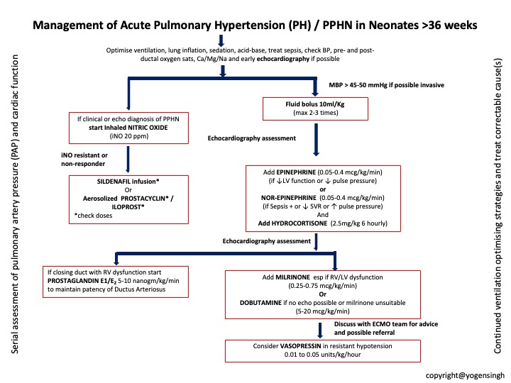
Second edition 2027​

Slide 32
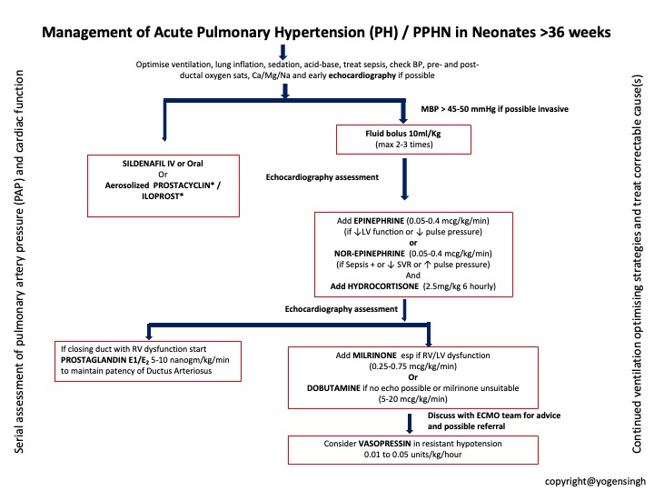
Second edition 2027

Slide 33


CDH babies did well 2002 to 2014 neurologically
I could not explain this at that point and Discussed with international experts researching in PPHN in many conferences . My Neuroprotection hypothesis was dismissed. 2014
Return of. Sherlock Holmes

Slide 34

NEUROPROTECTION. original research. 2023 2024 2025 First publication rajiv et al

Slide 35
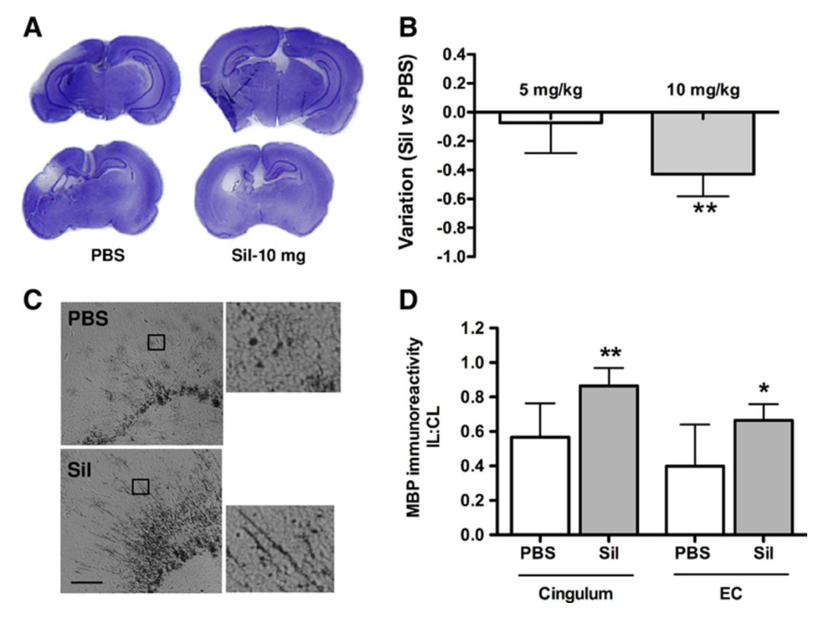
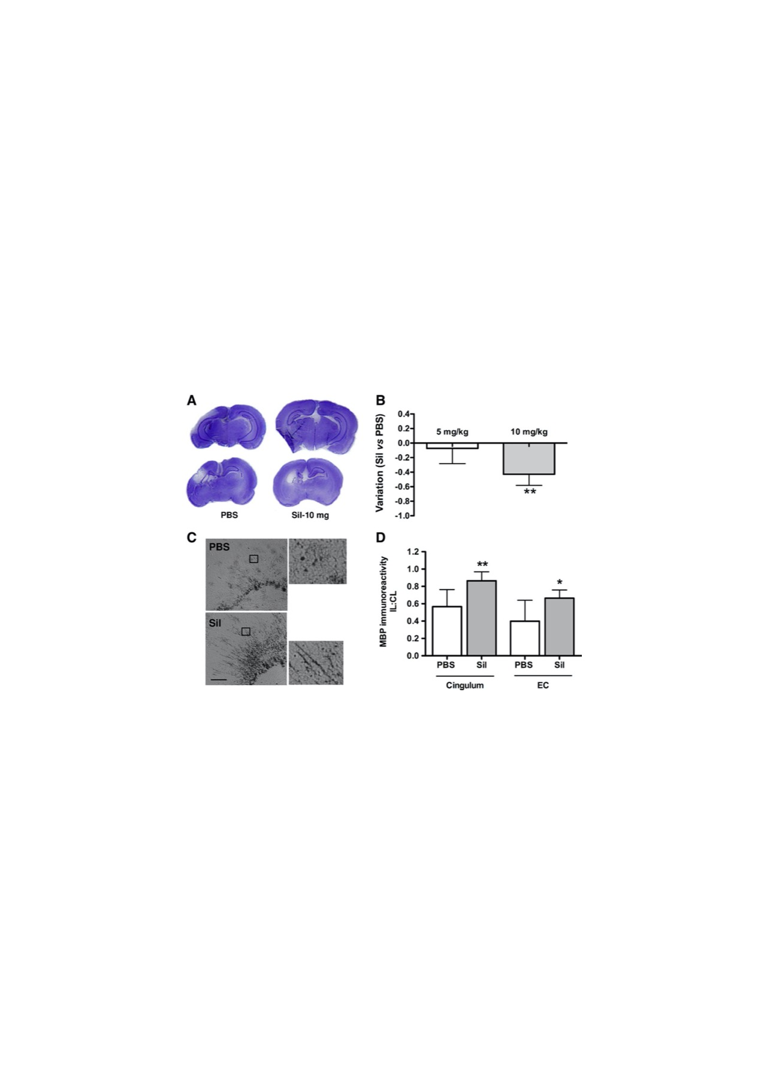
Sildenafil in Neuroprotection
Sildenafil Mediates Blood-Flow Redistribution and Neuroprotection After Neonatal Hypoxia-Ischemia
StrokeVolume 45, Issue 3, March 2014; Pages 850-856
Notes:
Effect of sildenafil on lesion size and myelinated fiber density 7 days after hypoxia-ischemia (HI). A, Representative cresyl-violet–stained sections at the level of the dorsal (upper) and ventral (lower) hippocampus in PBS-treated (n=12) and sildenafil-treated (Sil, n=12) animals. B, Variation in tissue loss 7 days after injury after treatment with 10 or 5 mg/kg sildenafil. C, Representative mouse antimyelin basic protein (MBP) immunolabeling in the cingulum and fragmentation of the myelin sheath in PBS and sildenafil-treated animals. EC: external capsule. Scale bars: 50 μm (20 μm in enlarged panels). D, Quantification of the optical density of MBP immunoreactivity expressed as the ratio of ipsilateral (IL) to contralateral (CL) labeling, (IL/CL)_{MBP}. *P<0.01, **P<0.001, sildenafil vs PBS treatment.

Slide 36
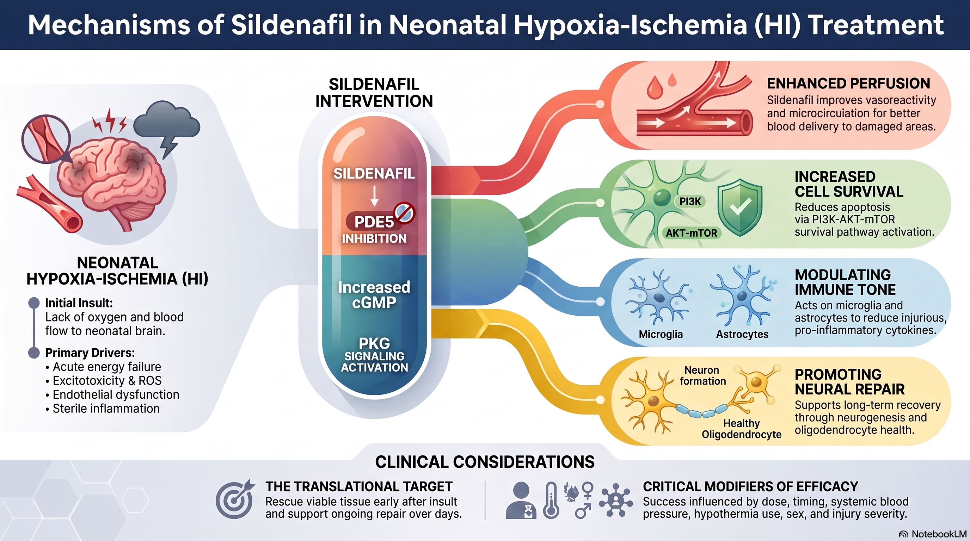

Slide 37
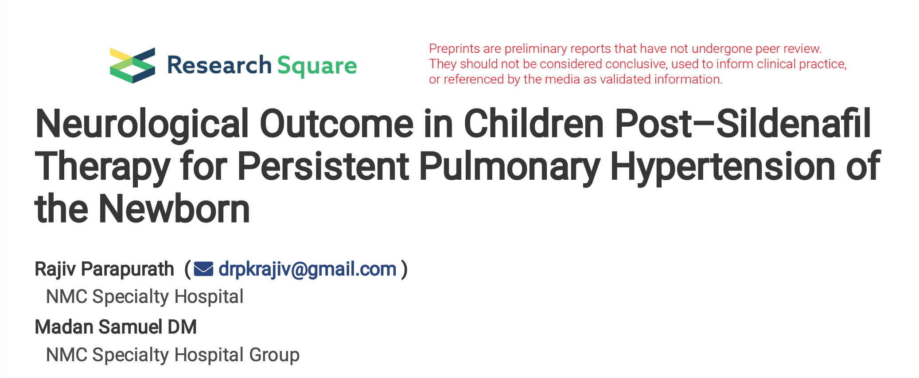

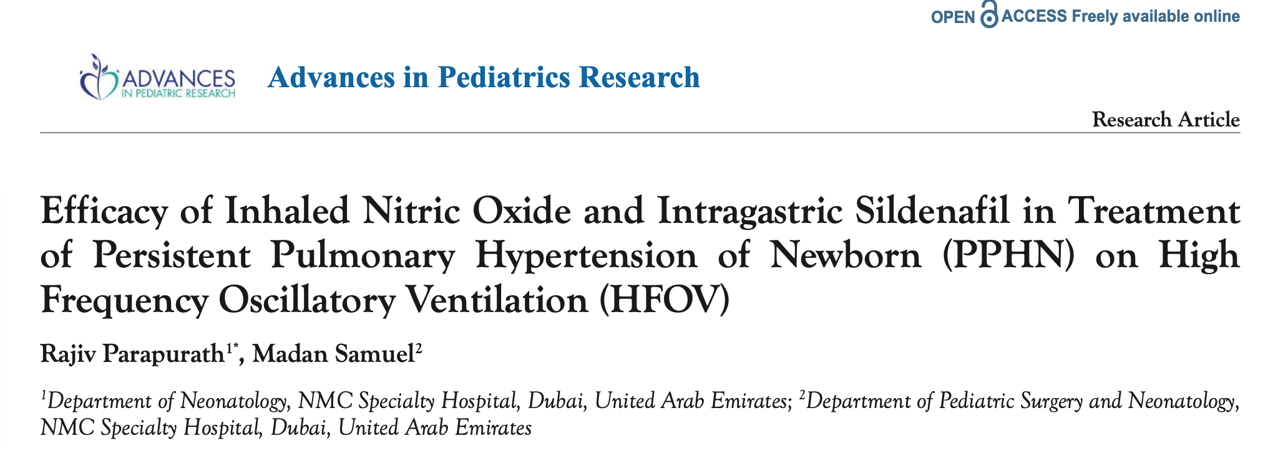
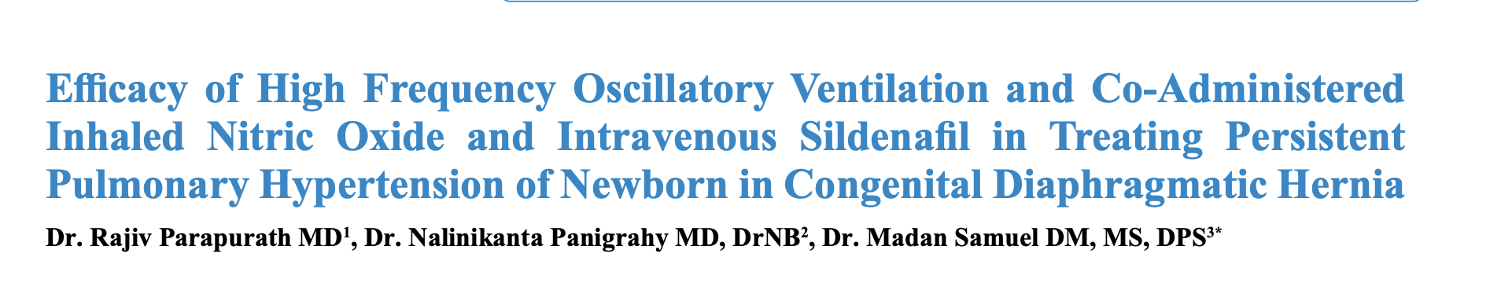
Efficacy. Of Sildenafil versus Inhaled Nitric Oxide 2023
Neurological. Outcome on 7 year follow up of babies given sildenafil for PPHN. 2024
Rajiv Parapurath et al

Slide 38
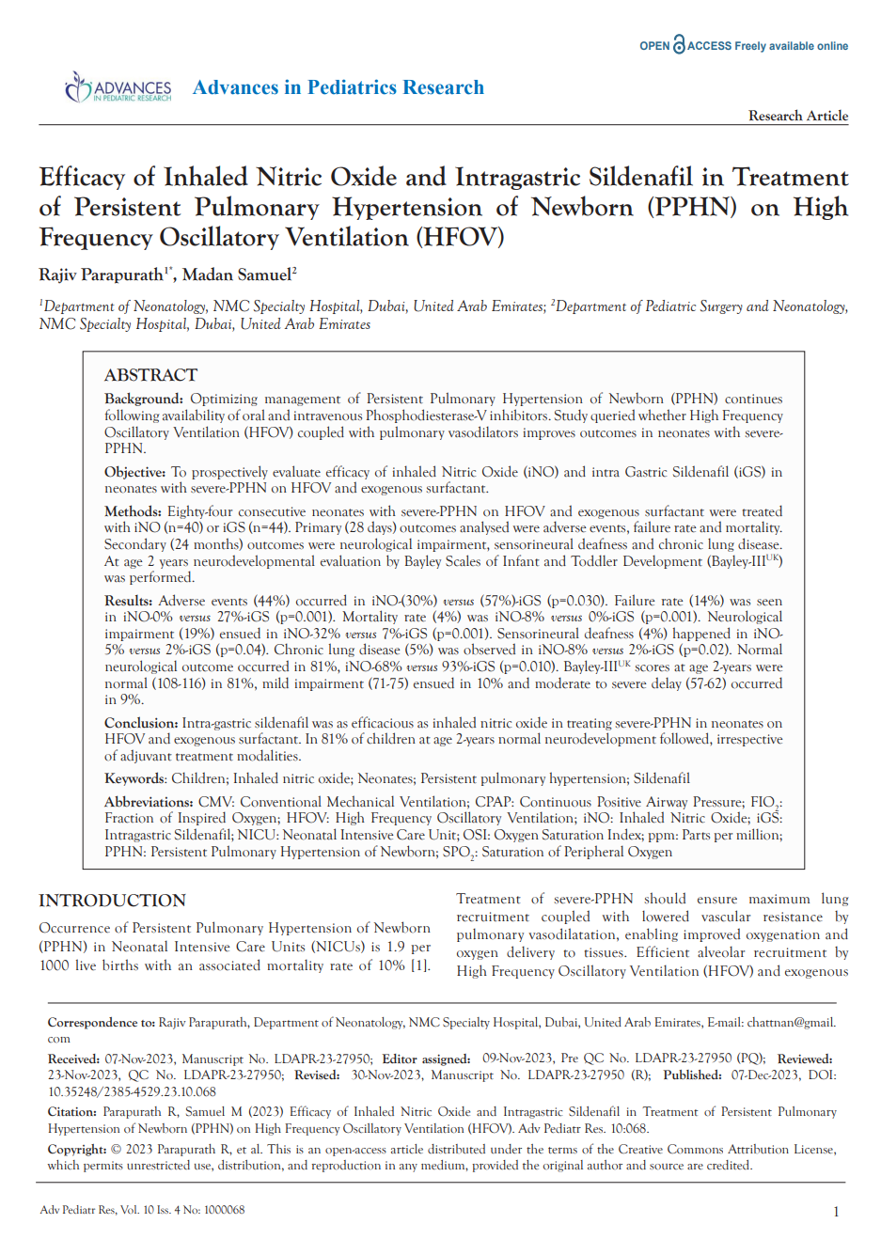
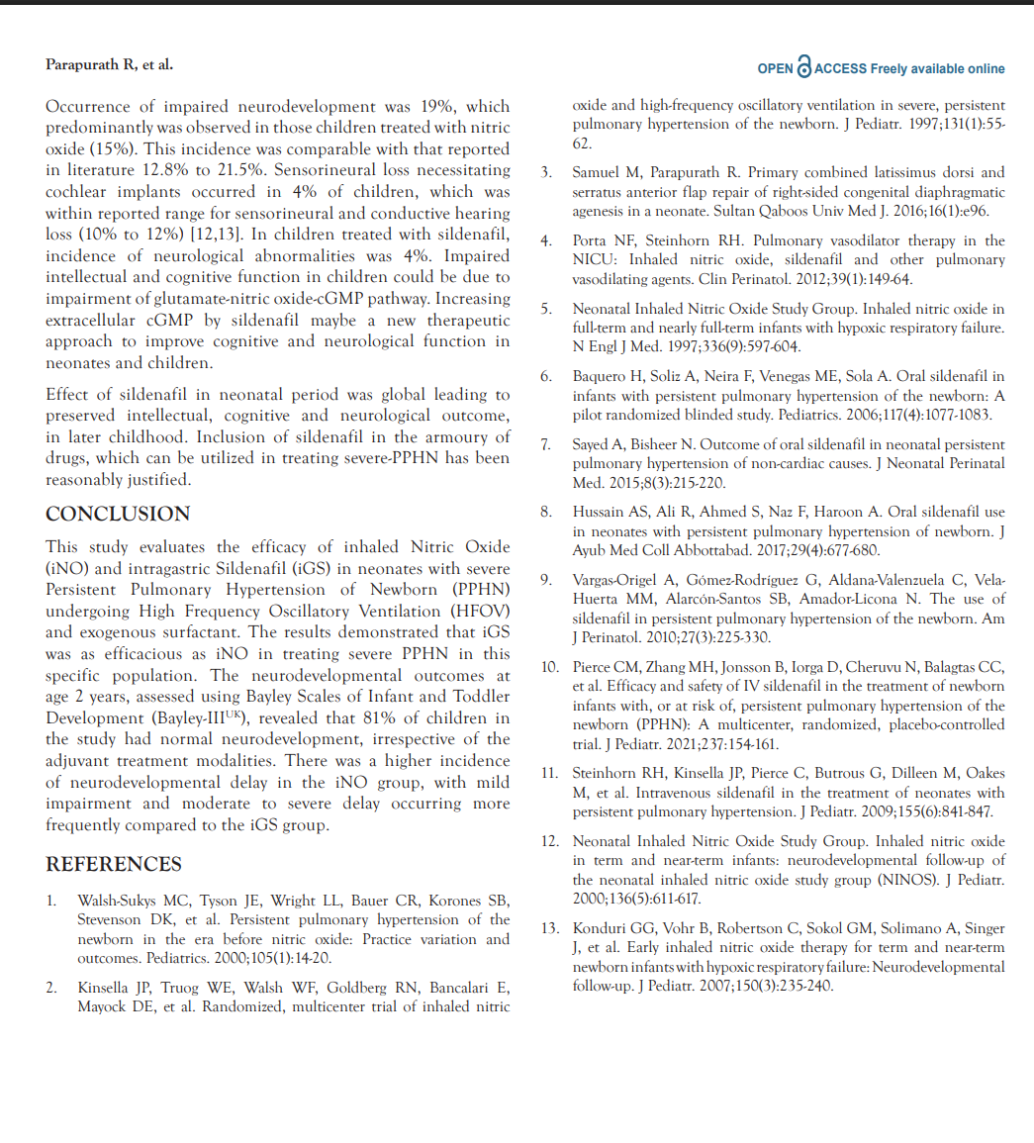
Original research 2023. Rajiv et al

Slide 39
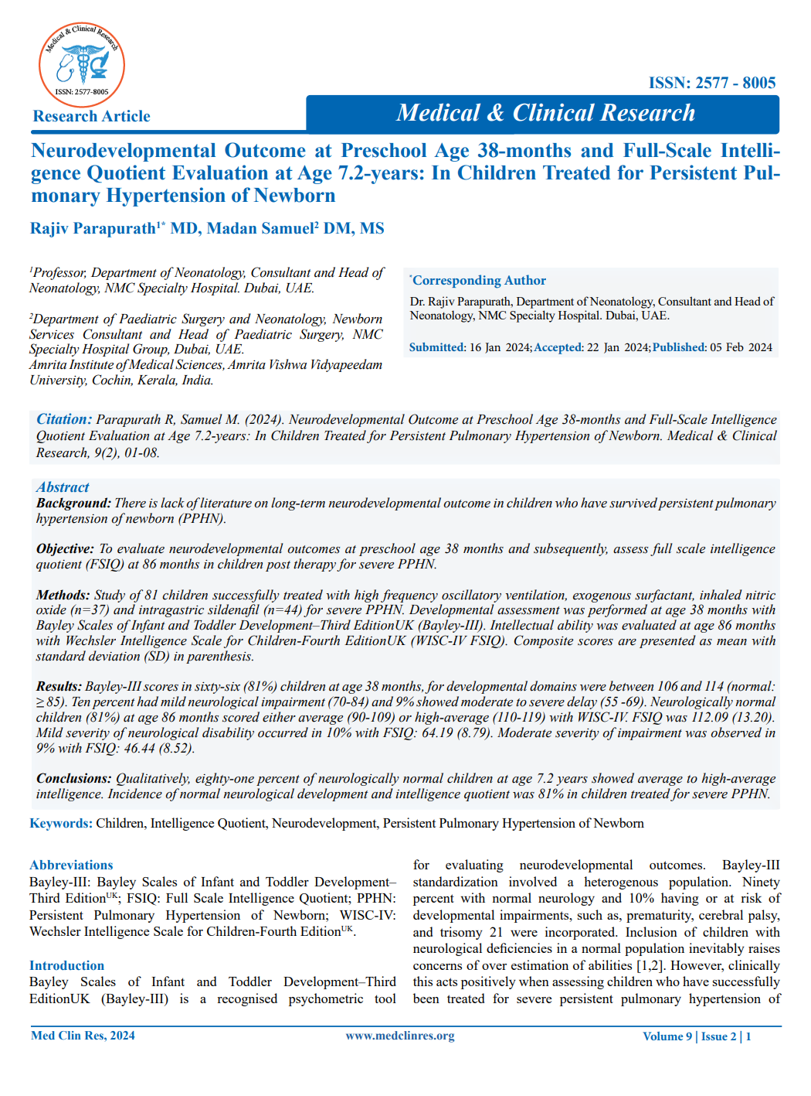
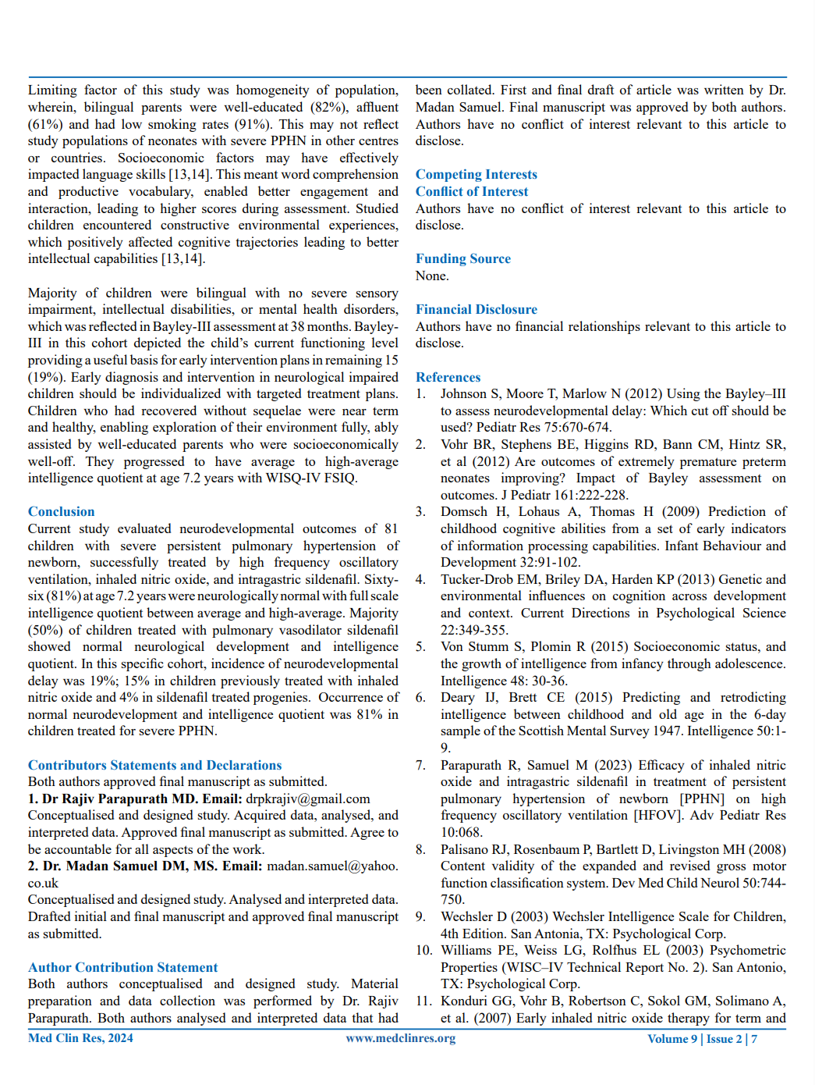

Slide 40
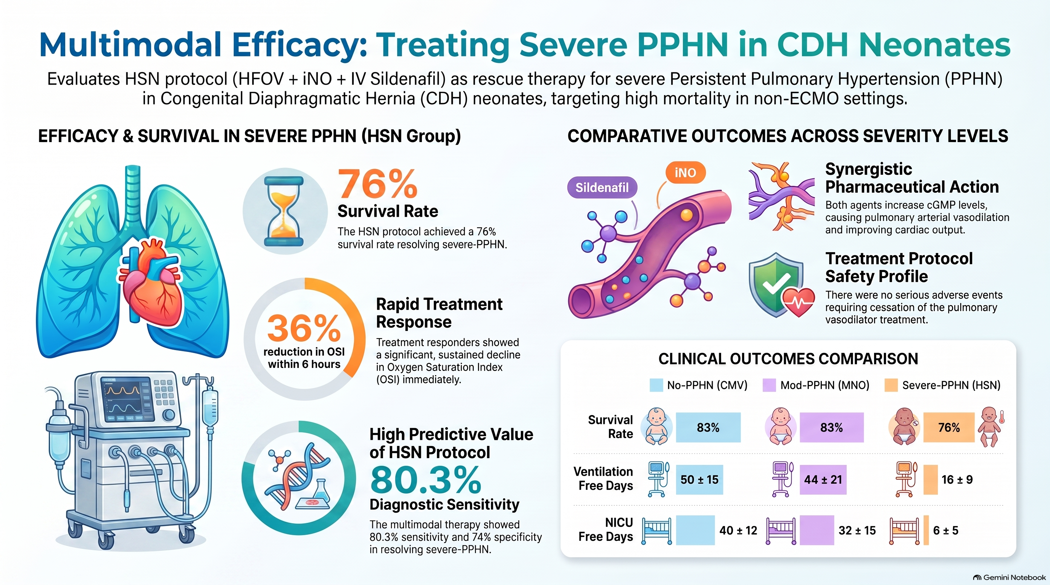
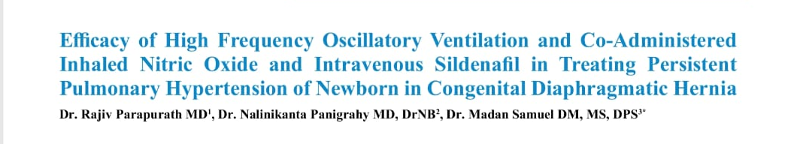
Original research 2025. Rajiv et al​
- Journal of PEDIATRICS PERINATOLOGY AND CHILD HEALTH

Slide 41
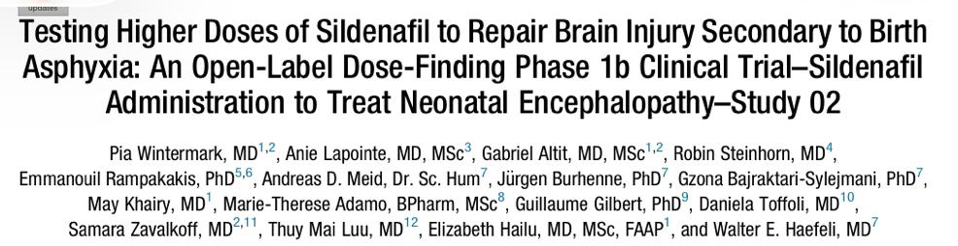
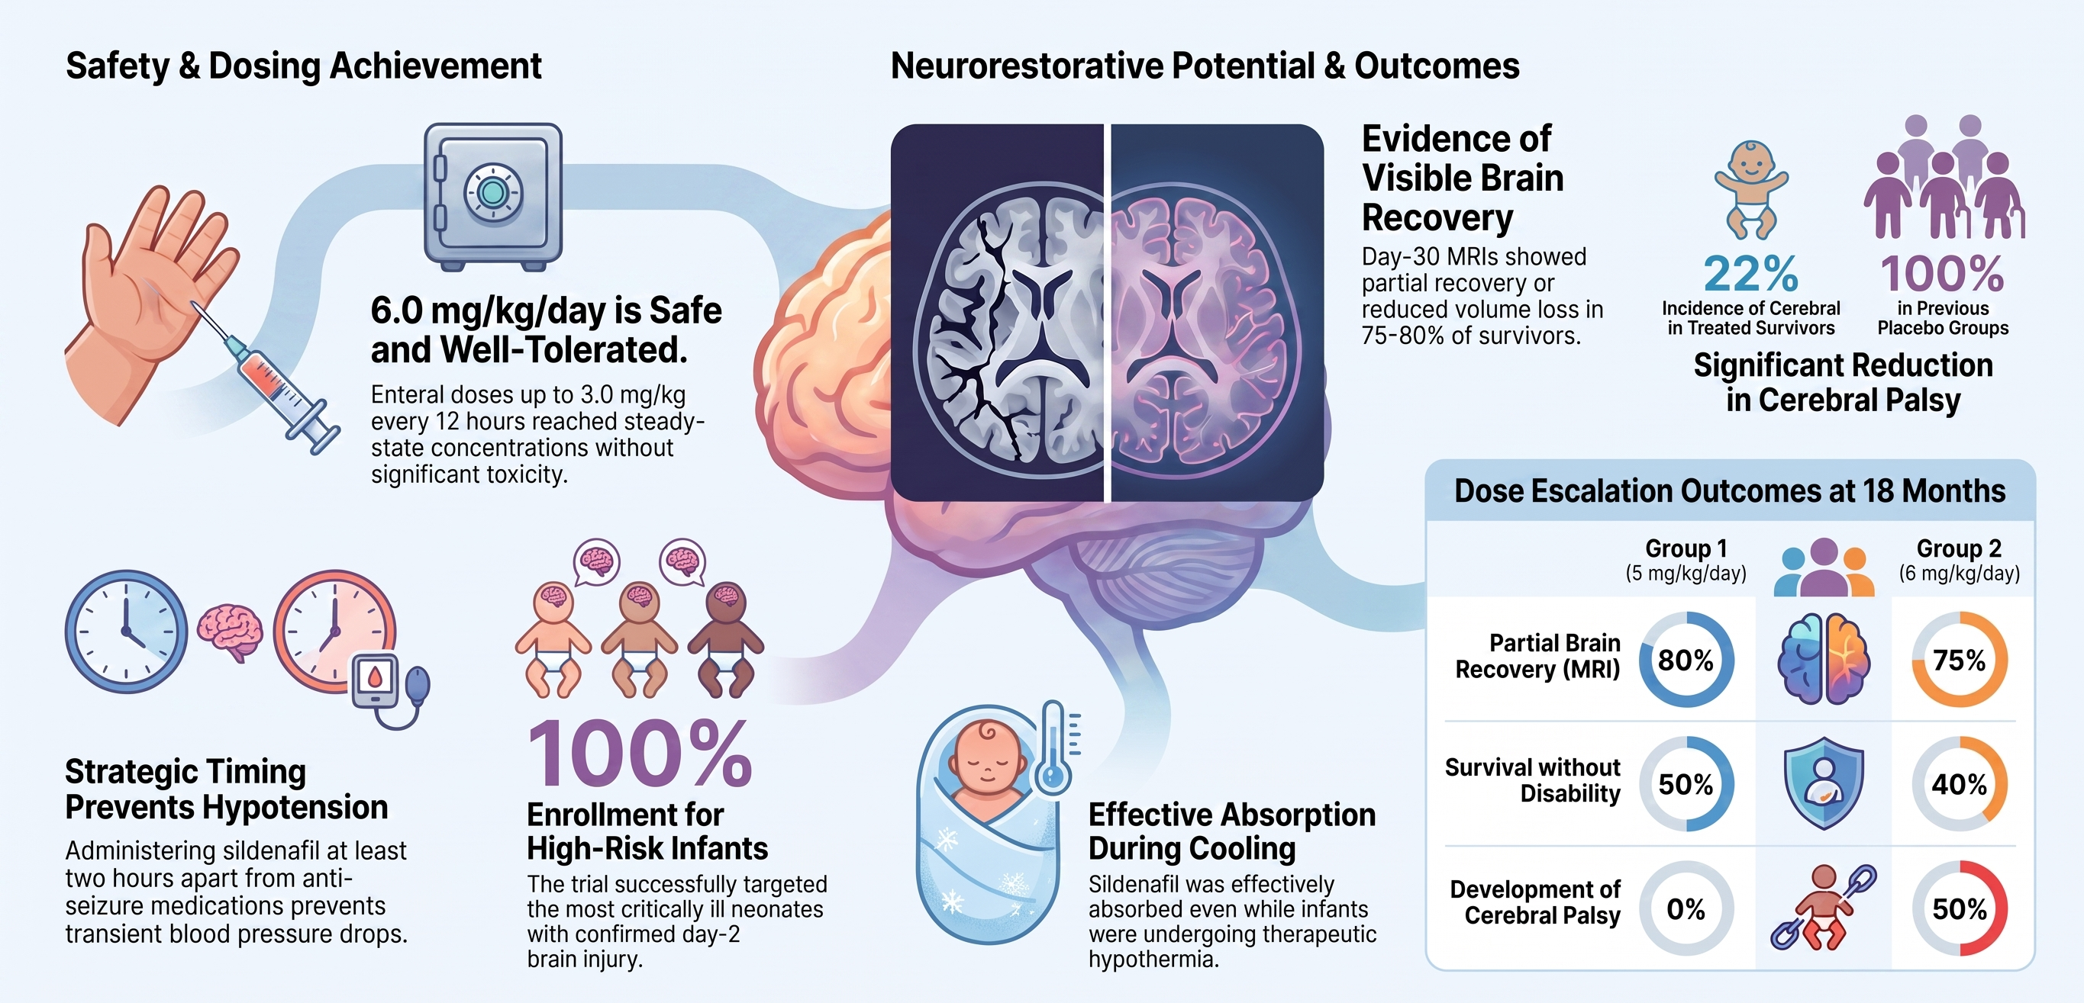
Oral Sildenafil in Hypoxic Ischemic Encephalopathy J.Pediatrics 2025

Slide 42
The evolution of assisted ventilation in newborn intensive care has made a unique paradigm shift. Noninvasive ventilation, a significant milestone in the 1970s, has made a comeback in the current decade. Newer methods of synchronization, gentle ventilation, and permissive hypercapnia using both invasive and noninvasive modes are the standard of care in neonatal intensive care today. This book is a Herculean attempt to standardize and optimize ventilatory care at the bedside. Each chapter is written by international experts in the field, hoping to ignite a path to the successful resolution of the pulmonary dysfunction, without lung and brain morbidity. Technologies of promise of the future are incorporated, and noninvasive monitoring and assessment are given significant emphasis. The neonatal intensivist is currently exposed to a huge arena of ever-evolving technologies. The bedside practitioner will find this book helpful in knowing the benefits and limitations of these technologies and support neonatal gas exchange without compromising neurodevelopmental outcome. More advanced technology is not always better. Simple techniques such as nasal CPAP with noninvasive monitoring have great outcomes in preterm and term infants with lung injury. This book gives great emphasis to this basic technology. The chapters are designed to evolve from the basics to applied physiology and graduate through the assisted ventilation technologies. A section on cardiac issues in respiratory care, nutritional support, and ancillary care is deliberately magnified for the intensivist to manage accurately and objectively a critical neonate with respiratory distress. This book with E-Book facilities of videos on critical chapters supplemented by lecture presentations would prove to be a handy and reliable bedside companion for all NICUs all over the world. The presentations and illustrations are provided to assist in education of a new generation of neonatal providers. We gratefully acknowledge the authors for contributing to these chapters, and providing videos and illustrations to enhance the book.

Slide 43
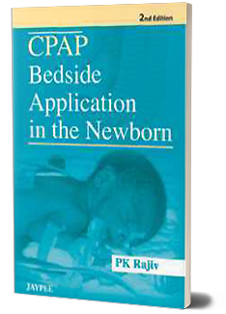
The incidence of low birth weight and prematurity remains high in many countries and neonatal mortality and morbidity continue to be major health resource problems. Respiratory disorders form a major chunk contributing to neonatal mortality. There remains an emergent need to streamline the health delivery into a three-tier system which is hospital-based, and the use of indigenous or low cost systems of respiratory assistance. Neonatal research is evolving day-by-day and a lot of advances have been made in the respiratory support of sick newborns. In the 1970s, Gregory by his principle of application of CPAP created a distinct awareness based on its singular impact in neonatal respiratory care. This initiated the innovative advances in the generation and delivery of CPAP. The concept of gentle ventilation and preservation of spontaneous breathing of infants made by Dr Jen Wung, Columbia University in the 1970s threw new light in the utility of CPAP in neonatal respiratory disorders. The impact of the ever-increasing cost of neonatal intensive care on the distribution of health resources must not be underestimated. In the current economic status of a country, it is important for professionals who deal with newborn infants to review their practices and identify ways and methods of providing effective care in a cost-effective manner. CPAP is the simplest, effective and economic way of respiratory support, which when practiced universally in a structured fashion, would save thousands of lives. It is a device of respiratory assistance suitable in all the countries where everyone cannot afford costly ventilation and surfactant. In this given scenario, every health care personnel dealing with newborn care should have a sound working knowledge of CPAP. These logistic implications made me to write this book. It is structured in such a way, to present the practical aspects of CPAP in a simple and user-friendly way. This book is intended to be used as a handbook by pediatricians and health care personnel who care for the neonates in a nontertiary institution. This book will serve the purpose of giving critical guidelines in the bedside management of CPAP to health care professionals dealing with neonatal respiratory care.

Slide 44


Our Unit use INO reduced by 80 percent in two decades.
Posterior tibial pulsation gives a clue to complex interactions in PPHN
Don’t bash the lung Wung 1985
Sildenafil Neurodevelopmental outcome outstanding
THANK YOU!

Slide 45

NEUNE
IonVentilation @Neurprotection
CPAP /IMV. SIMV /HFO TH. NSIMV NHFO VG
Sildenafil

Slide 46
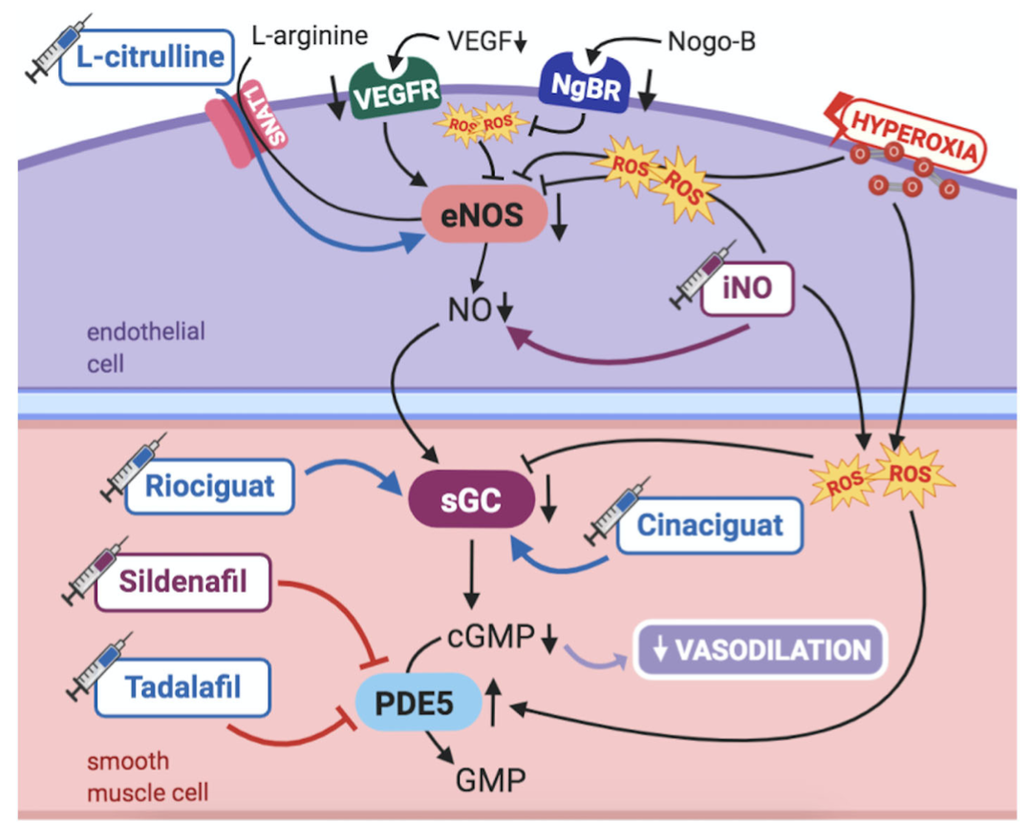
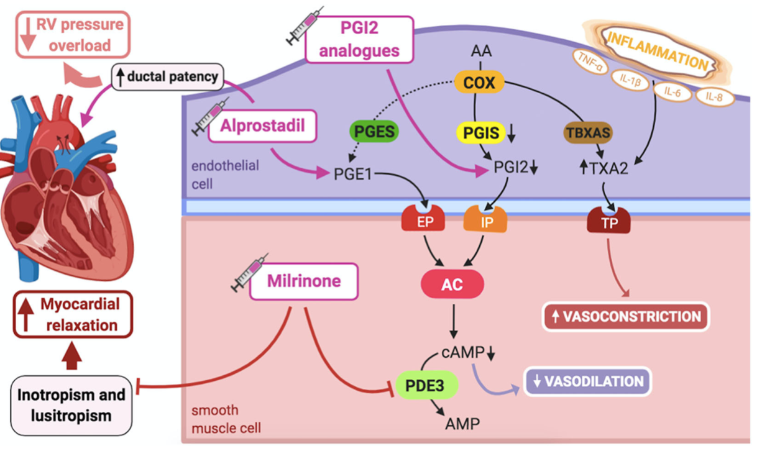
Sildenafil in PPHN – Where Do We Stand
Frontiers in Pediatrics ,JULY 2020

Slide 47

HFOV
2002 - 2015
Vent optimize
PEEP/MAP
HFO
Intravascular volume
SpO2 = 90-95%
PaO2 = 60 mmhg
MAP>12 \CVP<5
Lung Volume Optimization
#Targeted invasive BP values
Targeted echo cardiac parameters
FiO2– 1.0
OI> 20
SILDENAFIL(oral) 1mg/kg
f/b 2mg/kg after 3 doses
IV = 0.14mg/kg/h X 3h, then 0.07mg/kg/h
or
Serum sildenafil level >40mg/ml
OI 10% , PAP<10%,P/F ratio , PaO2 10mmhg
(MILRINONE iv 0.5mcg/kg/min)
Success
Preductal SpO2, ABG, posterior tibial arterial palpation, Urine Output
(BOSENTAN iv 1mg/kg 12th hourly)
LV dysfunction
No LV dysfunction
*
*
*Echocardiographic criteria
FiO2 1.0 OI 25
INO
CROSSOVER
Ventricular physiology
FiO2 0.6
OI >40
$Dr AUGUSTO SOLAS Study 2006 Oral sildenafil
Weaning
ECMO
ONLY IN DEVELOPED COUNTRIES
Notes:
OSI. - Non Invasive Surrogte of OI = MAPx FIO2. / SPO2 ( It is 50% of OI), Rule of 10 for response to Sildenafil = 10% decrease in OI, 10mmhg increase in PaO2 , 10% decrease in PAP .

